Slide 1
The Influence of Working Memory
on Reading and Creative Writing Processes in a Second Language
Human Factors Psychology Lab,
Seoul National University
Summer 2019
{Salim Abu-Rabia (2003)}
{Educational Psychology}
Presented by {Soomin Cho}

Slide 2
Content
Introduction
Hypothesis
Methods
Results
Conclusion

Slide 3
Introduction
Purpose
the influence of working memory (WM) on reading and writing
measure both the processing and storage functions of WM
Rationale
In one’s second language (L2) linguistic processes and problems can be detected very often.
predicting that similar difficulties will appear in both languages because of a central processing deficit.

Slide 4
2. Hypothesis
Question 1. What makes one individual a great writer?
Link into WM’s processes
Figure out how to improve the writing skills of weaker writers
Question 2. Language comprehension proficiency and WM capacity?
The proficiency would depend on WM
Significant correlation

Slide 5
2. Hypothesis
Daneman and Carpenter (1980)
“the efficiency with which an individual processes language is determined by their WM capacity.
=> writing and reading undoubtedly share several basic components.

Slide 6
3. Methods
Participants
47 high school students
37 native Hebrew speakers
8 native Russian speakers
Rationale
Younger => Better deal with L2

Slide 7
3. Methods
Tasks
Test of Written Language
a comprehensive standardized measure of writing ability
10 subtests:
spelling, vocabulary, style, logical sentences, sentence combining, thematic maturity, contextual vocabulary, syntactic maturity, contextual spelling, contextual style

Slide 8
3. Methods
2 . WM - Reading Comprehension
determine subjects’ WM capacity
procedure
reading two passages
answering four questions
Pronoun reference
In the first passage, the distance = 2 sentences
In the second passage, distance = 6 sentences
Fact (2)
Thematic (theme of the passage)

Slide 9
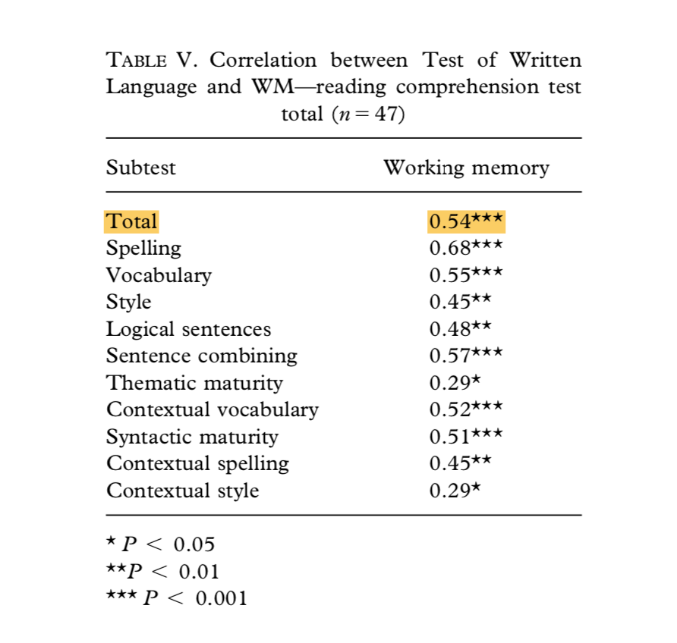
Four Results
Significant correlation occurred
between the WM task (the reading comprehension task)
and the subtests
and total Test of written Language

Slide 10
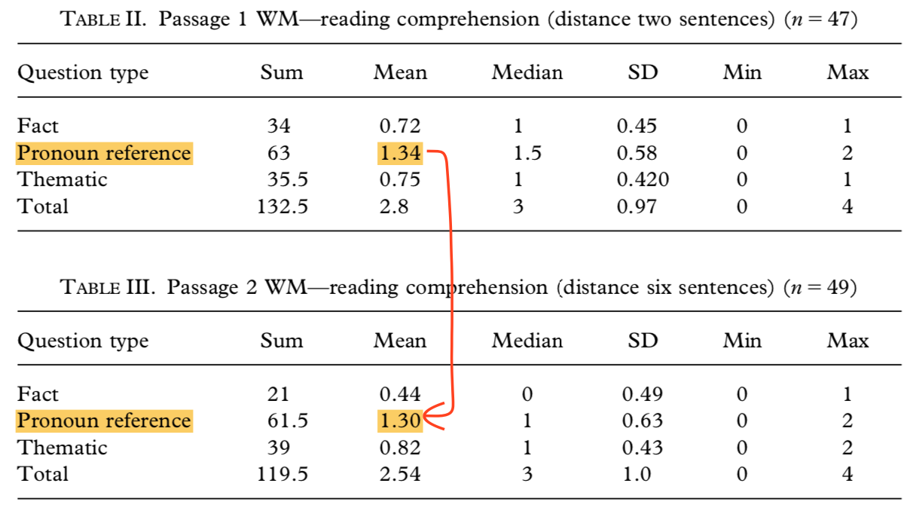
Four Results
Marginal effect
The distance between a pronoun and its referent
ability to recall the referent
=> the individual’s working memory was at work here.

Slide 12
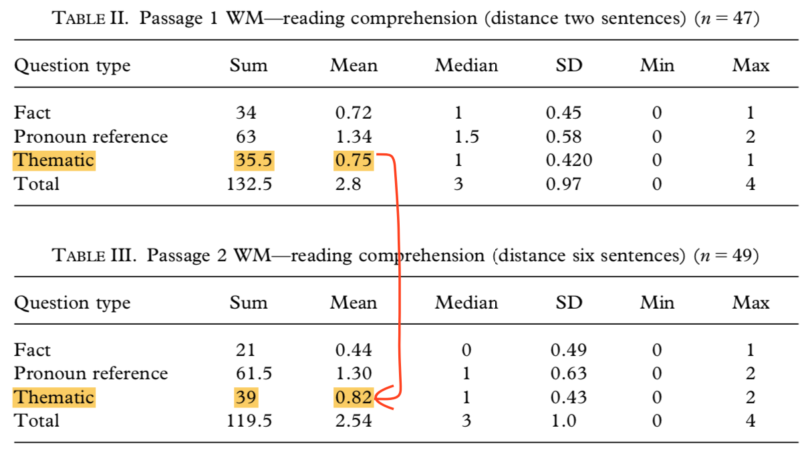
Four Results
Weaker Correlation
Thematic Maturity subtest showed one exception
measure the instances where the subject used names of characters, objects and so on.
=> Written proficiency and WM are not necessarily displayed by use of proper names and objects.

Slide 14
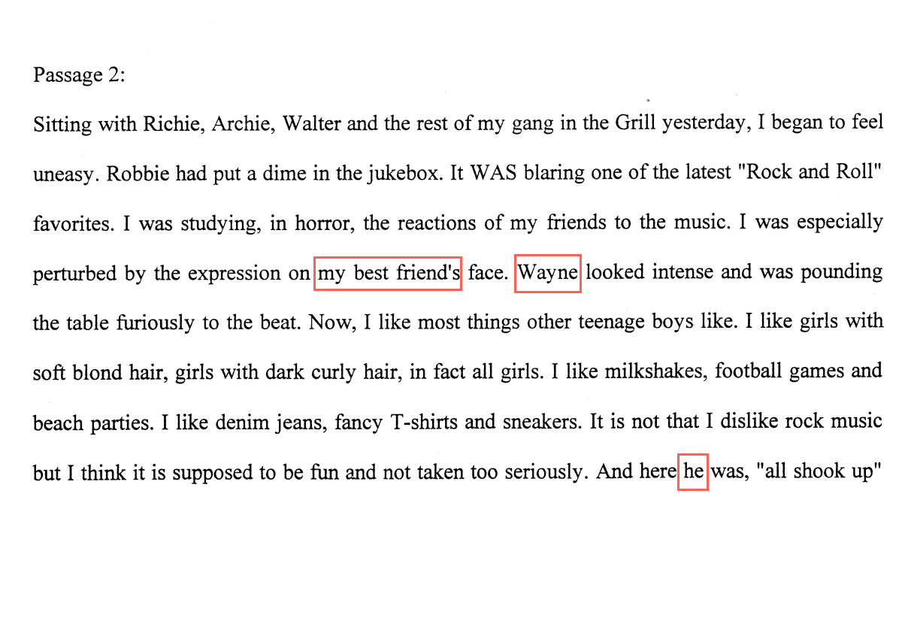
Four Results
Forgetting words
Forget words in the dictation
Substitute “a” for “the” vice versa
EX) “Wayne”= speaker’s best friend
some wrote “my best friend,”
others wrote “his best friend,”
yet others wrote a distortion of the name Wayne.

Slide 15
5. Conclusion
Assumption
confusion of name “Wayne” <= lack of familiarity.
a semantic field was accessed and activated
while answering questions regard to the other incorrect answers
phonology in WM would be also activated.

Slide 16
5. Conclusion
Difficulty
categorically isolating the WM component of language.
Future Research
While using similar WM tasks
names should be culturally based
significance of the erroneous responses should be studied.
In order to verify the accuracy of subjects
interviewing them upon conclusion of WM and writing tasks

Slide 17
Thank You for Your Attention

